Slide 1
NodeJS for Beginner

Slide 2
Outline
Installing NodeJS
Introduction
Basic
Variable & Scope
Control Flow
Function
Class / Object
Understanding Async
Callback
Promise (intermediate)
Nested Callback (intermediate)
Generator function (intermediate)

Slide 3
Introduction

Slide 4
What is Javascript
A scripting language
Client side script to interact with user (commonly used as a part of web browser)
A “dialect” of ECMA Script (ES)

Slide 5
What is NodeJS
Node.js is a platform built on Chrome's JavaScript runtime (V8) for easily building fast and scalable network applications.
Open source, cross platform.
Node.js = Runtime Environment + JavaScript Library

Slide 6
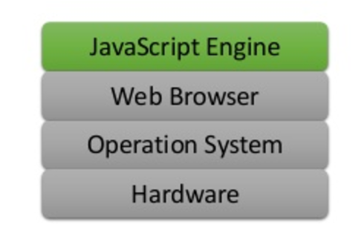
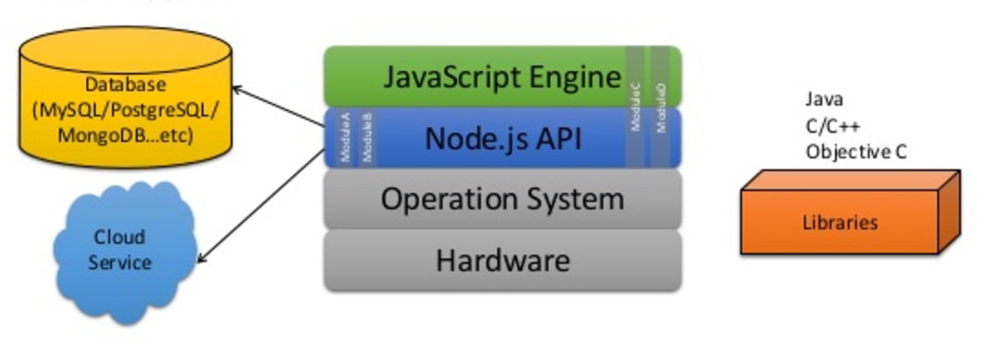
Let’s compare!
Oldschool Javascript
Javascript w/ NodeJS

Slide 7
NodeJS Features
Asynchronous (Non Blocking I/O)
Event driven
Single Threaded but Highly Scalable
Built-in HTTP Server
Compile the javascript

Slide 8


Blocking v.s Non-Blocking I/O
Blocking I/O
Non Blocking I/O

Slide 9
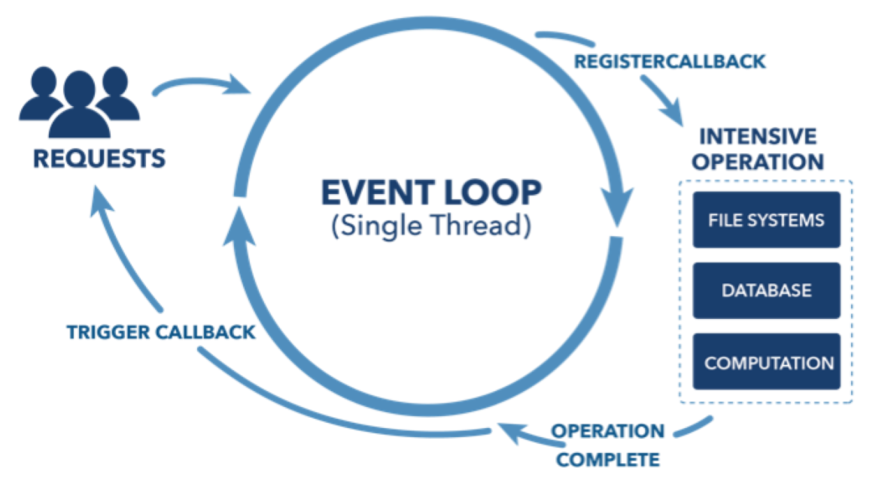
Non-Blocking I/O Mecanism in NodeJS

Slide 10
Interpreter v.s Compiler
Oldschool javascript is interpreted language.
Javascript in Nodejs will be compiled by V8 (but not fully)

Slide 11
Basic

Slide 12
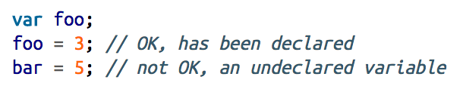

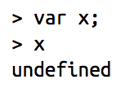
Declaring Variable
Let’s declare with var
Or, you can combine it
Uninitialized variable is undefined

Slide 13
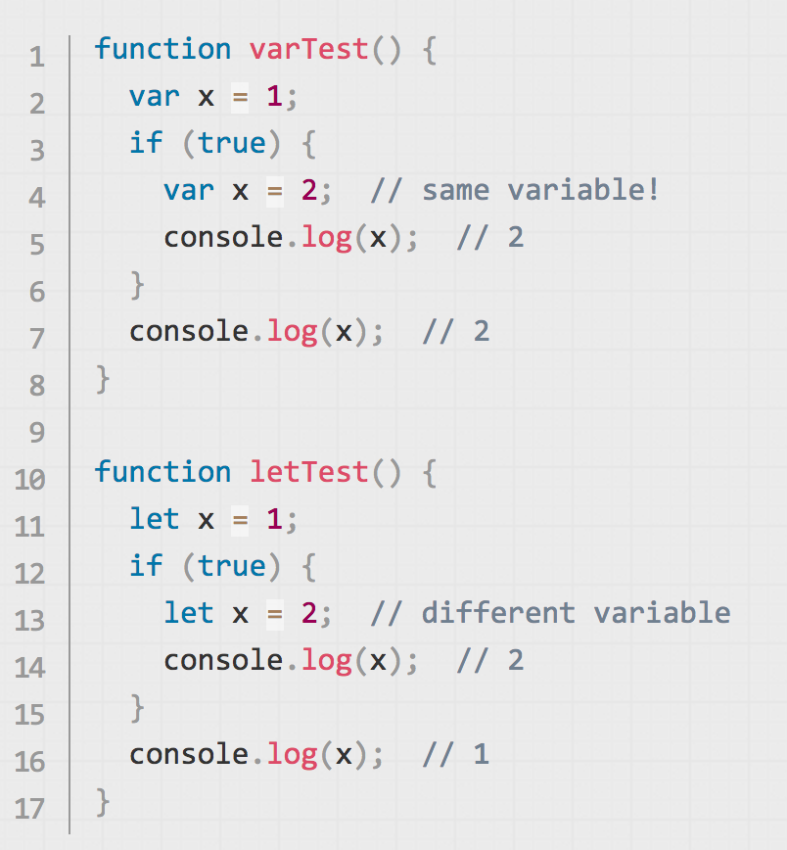
Let v.s Var
let works very much like var.
The main difference is that the scope of a var variable is the entire enclosing function
Notes:
Refs: https://developer.mozilla.org/en/docs/Web/JavaScript/Reference/Statements/let

Slide 14
IIFE?

Slide 15
Control-Flow
Condition
If, elseif , else
Switch
Iteration / Looping
For
For/in
While
Do/while

Slide 16
Function
Cara 1 | Cara 2
function sum(a, b) { return a + b; }; var p = 2; var q = 3; var r = sum(p, q); // r = 5; | var sum = function(a,b){ return a+b; }; var p = 2; var q = 3; var r = sum(p, q); // r = 5;

Slide 17
Passing function as function’s parameter
Calculator
var operand1 = 6; var operand2 = 5; var operatorStr = “-”; if(operatorStr == “+”){ var operator = sum; } elseif(operatorStr == ‘-’){ var operator = minus; } var result = operate(operand1, operand2, operator); // result = 11 | // other library file function sum(a, b) { return a + b; }; function minus(a, b) { return a - b; }; function operate(a, b, operator) { return operator(a,b); };

Slide 18
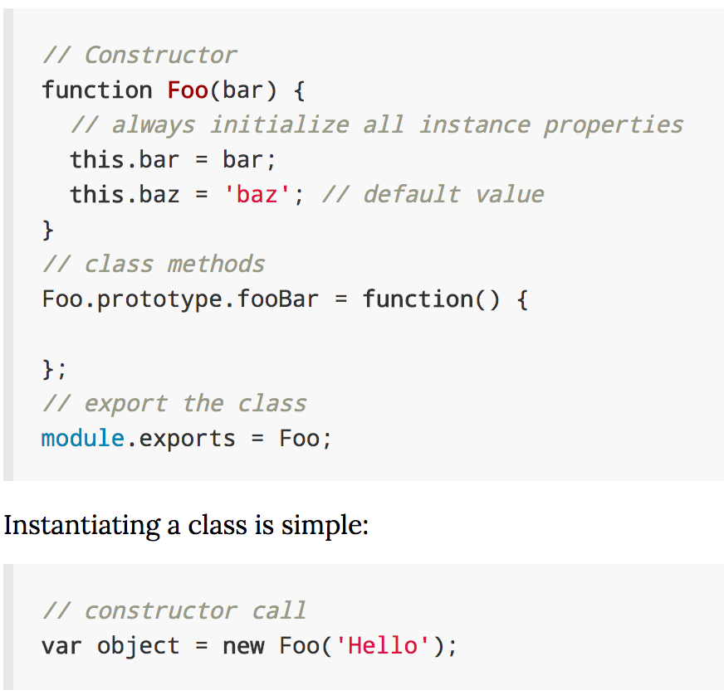
Class / Object
Javascript is an object-oriented programming language that supports delegating inheritance based on prototypes.
Each object has a prototype property, which refers to another (regular) object.
Properties of an object are looked up from two places:
the object itself (Obj.foo), and
if the property does not exist, on the prototype of the object (Obj.prototype.foo).
Notes:
http://book.mixu.net/node/ch6.html

Slide 19
Class / Object : Constructor
var Foo = function() { }; Foo.prototype.bar = function() { console.trace(); }; var f = new Foo(); f.bar(); | function Baz() { }; Baz.prototype.bar = function() { console.trace(); }; var b = new Baz(); b.bar();
Trace: at [object Object].bar (/home/m/mnt/book/code/06_oop/constructors.js:3:11) at Object.<anonymous> (/home/m/mnt/book/code/06_oop/constructors.js:7:3) at Module._compile (module.js:432:26) at Object..js (module.js:450:10) at Module.load (module.js:351:31) at Function._load (module.js:310:12) at Array.0 (module.js:470:10) at EventEmitter._tickCallback (node.js:192:40) | Trace: at Baz.bar (/home/m/mnt/book/code/06_oop/constructors.js:11:11) at Object.<anonymous> (/home/m/mnt/book/code/06_oop/constructors.js:15:3) at Module._compile (module.js:432:26) at Object..js (module.js:450:10) at Module.load (module.js:351:31) at Function._load (module.js:310:12) at Array.0 (module.js:470:10) at EventEmitter._tickCallback (node.js:192:40)

Slide 20
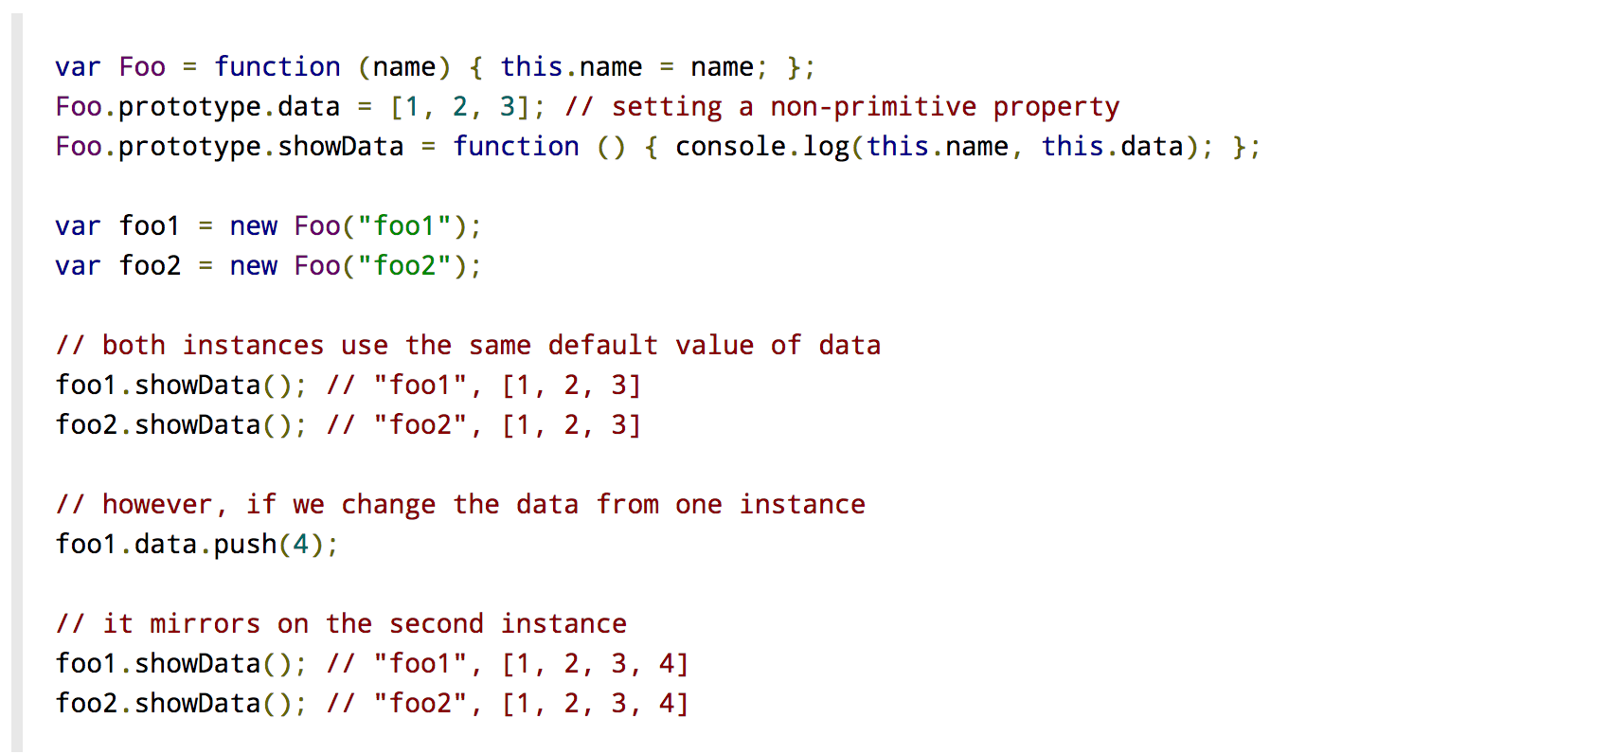
Class / Object : Understanding Prototype
AVOID THIS

Slide 21
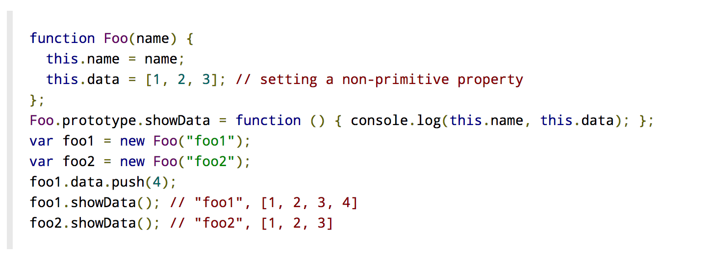
Class / Object : Understanding Prototype
RECOMMANDED WAY

Slide 22
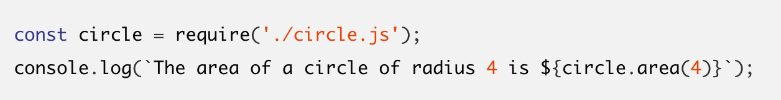
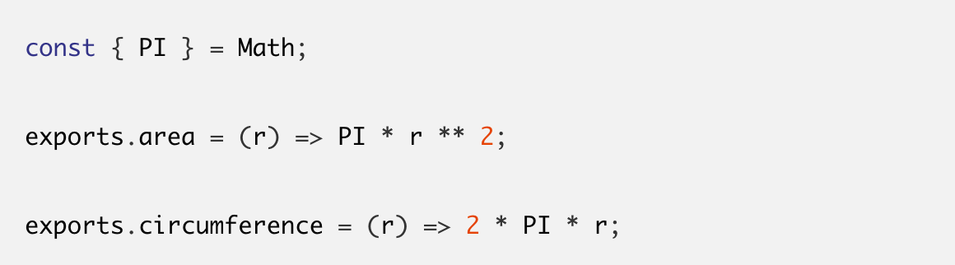
Require
circle.js

Slide 23
Async
const fs = require('fs') console.log('start reading a file...') fs.readFile('file.md', 'utf-8', function (err, content) { if (err) { console.log('error happened during reading the file') return console.log(err) } console.log(content) }) console.log('end of the file')

Slide 24
Async.js
async.parallel(['file1', 'file2', 'file3'], fs.stat, function (err, results) {
// results is now an array of stats for each file
})

Slide 25
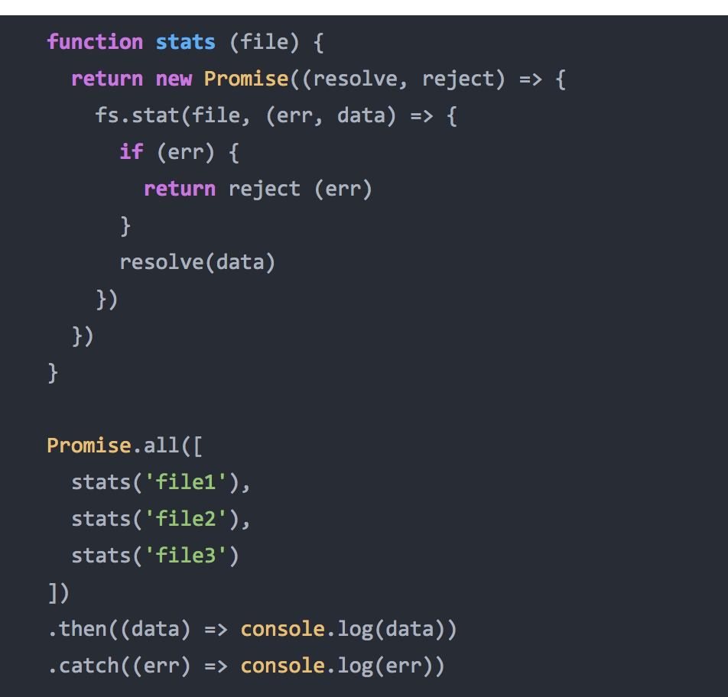
Promise
Notes:
https://blog.risingstack.com/node-hero-async-programming-in-node-js/

Slide 26
References
https://www.lynda.com/Node-js-tutorials/Understanding-asynchronous-tasks/370605/408265-4.html
https://strongloop.com/strongblog/how-to-generators-node-js-yield-use-cases/

